Slide 1
F17 FYS ~ PHYS 1101
What Really Happened: How Scientific Theories Come About
Theme 1: Galileo

Slide 2
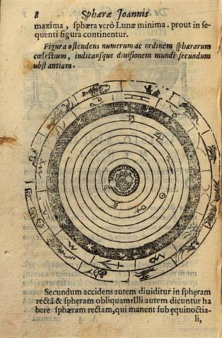
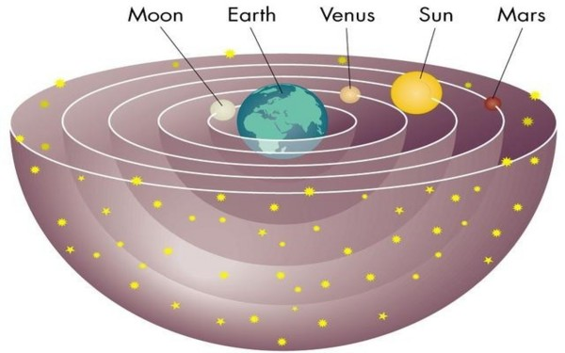
Ptolemian or Geocentric Worldview (Aristotelianism)

Slide 3
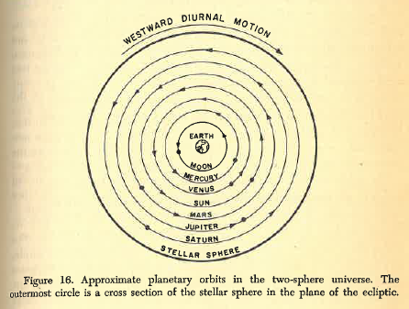
Ptolemian/Aristotelian Model of the World

Slide 4
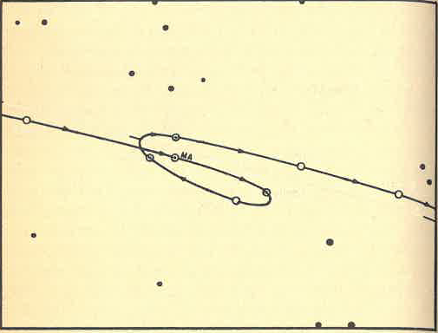
Problem: Retrograde Motion of Planets

Slide 5
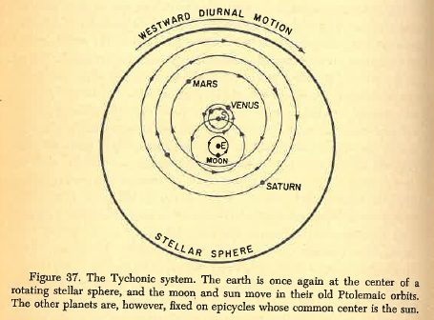
Tychonic System (after Tycho Brahe, Kepler’s Teacher)

Slide 6
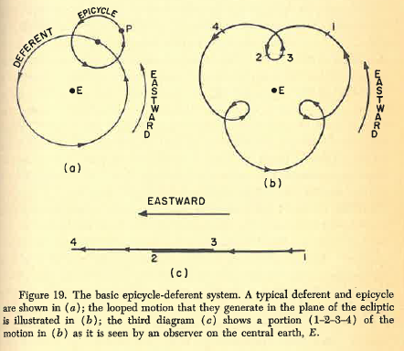
Resulting Complications in Ptolemian Model: Epicycles and Extants
Epicylces

Slide 7
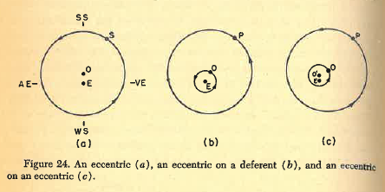
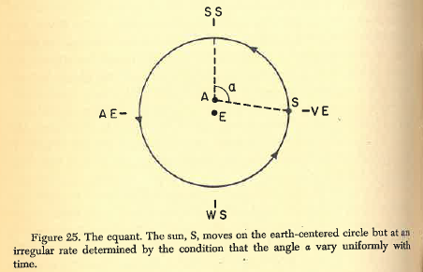
Ptolemian Complications continued
Further necessary corrections
The equant or extant

Slide 8
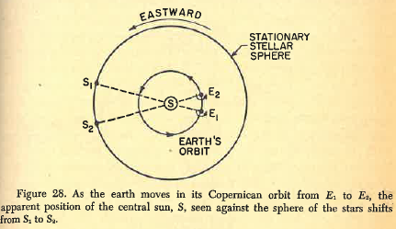
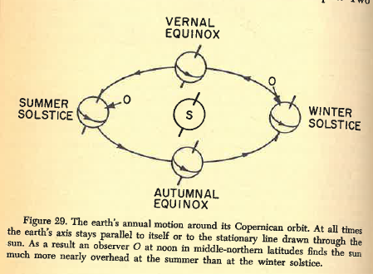
The Copernican Model

Slide 9
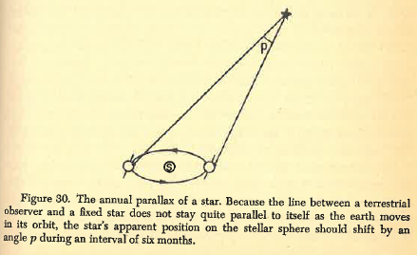
Problems With The Copernican Model

Slide 10
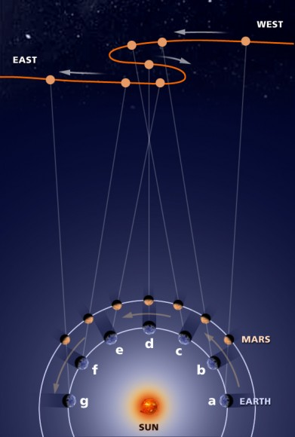
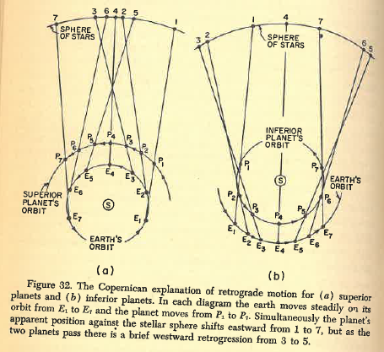
Copernican Explanation of Retrograde Motion of Planets

Slide 11
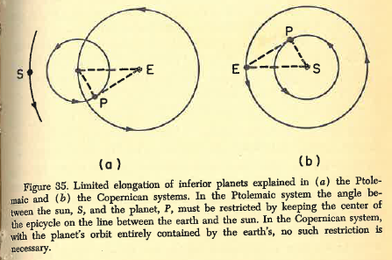
Differences of Explanation of Elongation in Ptolemaic and Copernican System

Slide 12
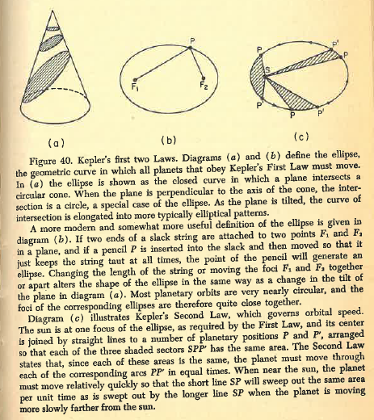
Kepler’s Laws

Slide 13
Evidence from Related Issues:
Jupiter’s Moons

Slide 14
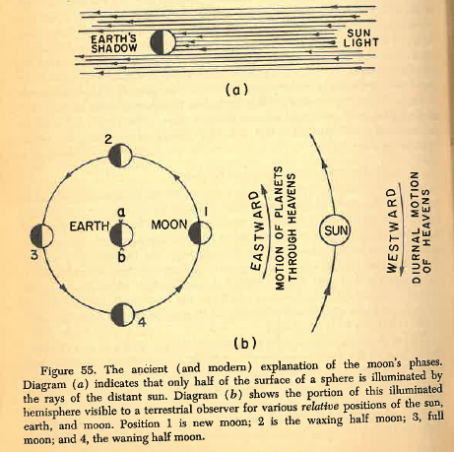
Eclipses
&
Phases of the Moon

Slide 15
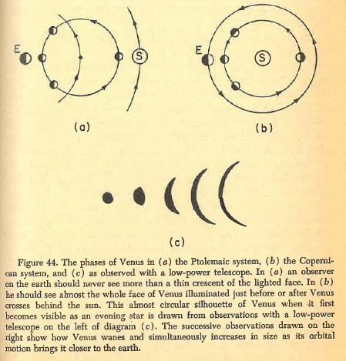
Phases of Venus

